Slide 1
Industrial Pharmacy II
By
Dr. Mohammed Sabbar
4th Oct. 2018
http://bit.do/ex2a6

Slide 2
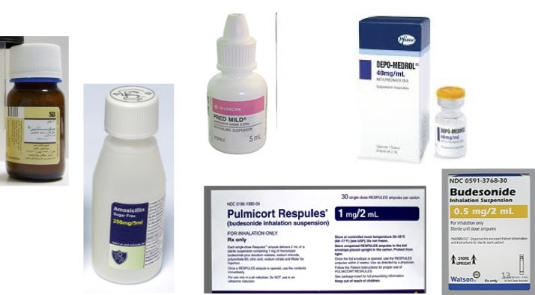
Suspensions
Definition: heterogeneous system , external and internal phases
External: liquid medium (dispersion medium)
Internal: discrete particles ( Dispersed Phase)
Notes:
That include in oral, parenteral, aerosol,. .. and ophthalmic dosage forms

Slide 3
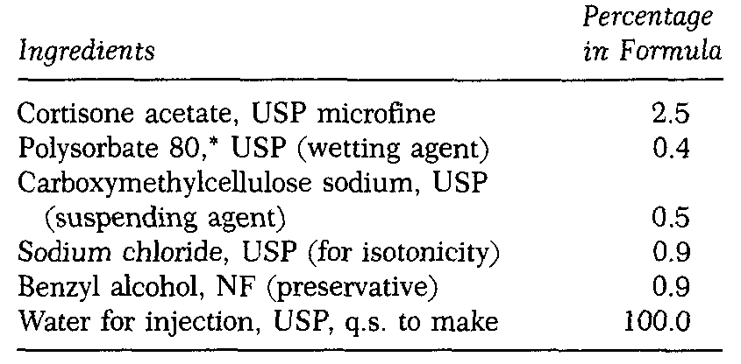
Example:

Slide 4
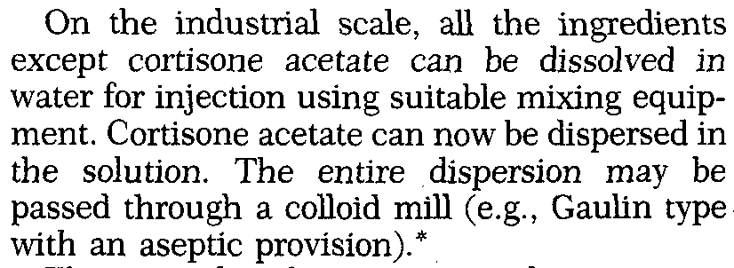

Slide 5
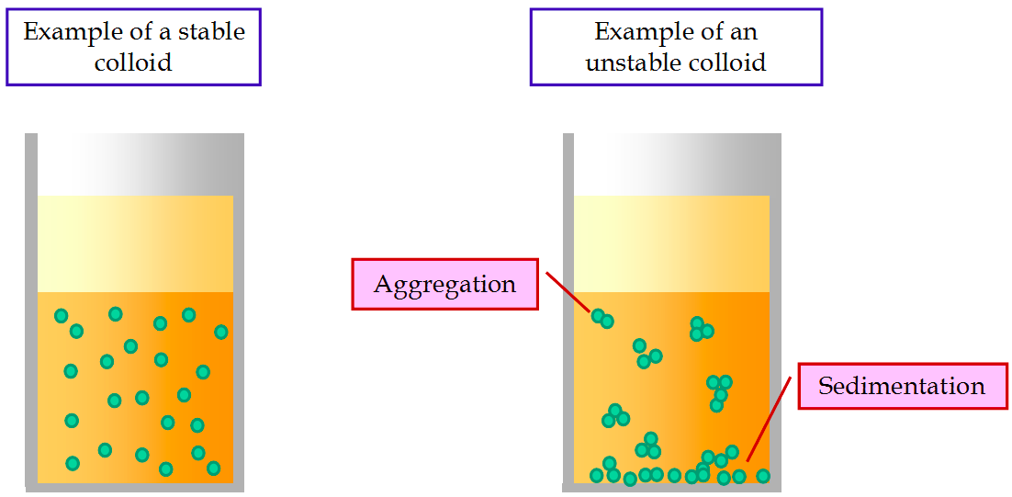

Slide 6
Suspensions
Formulators have to concern to decrease rate of particles settling and to permit easy resuspendability of any settled particulate matter.
A satisfactory suspension is that remain sufficiently homogeneos for at least the period of time to take and administer the required dose after shaking.

Slide 7
Why?
Stability, solubility, palatability, control release
Example for each??

Slide 8
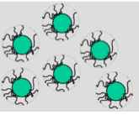
Wetting
Notes:
Wetting: It is important to form film over surface of the solid particle and it needs high affinity between the liquid medium and solid.
Example Sulphur in water

Slide 9
film over surface of the solid particle
high affinity between the liquid medium and solid.
Weak or no affinity makes difficulty of liquid to displace air from the solid lead to???
Interaction depend on hydrophilicity and hydrophobicity of solid and solvent or medium
Used of intermediate solvent
Notes:
Wetting: It is important to form film over surface of the solid particle and it needs high affinity between the liquid medium and solid.
Example Sulphur in water

Slide 10
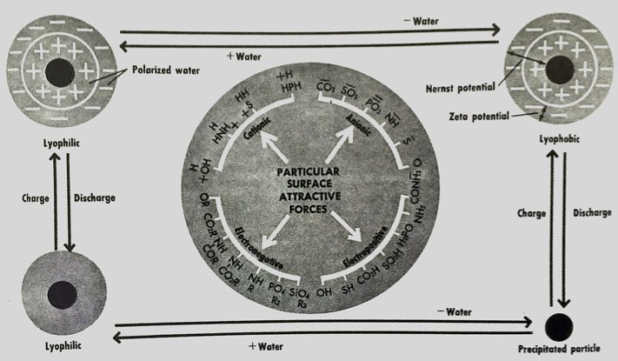
Particle interaction and behavior

Slide 11
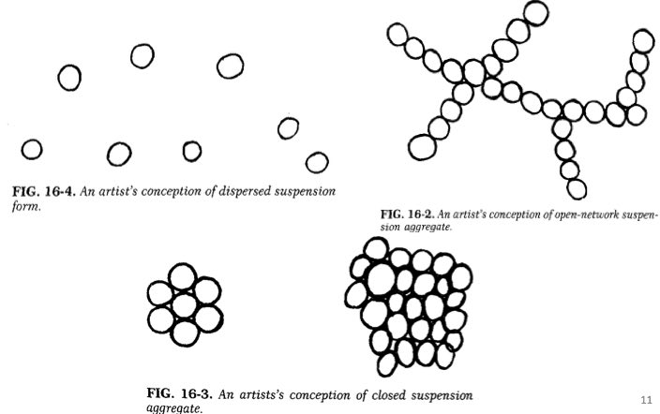
Aggregates: open networks, closed aggregate

Slide 12
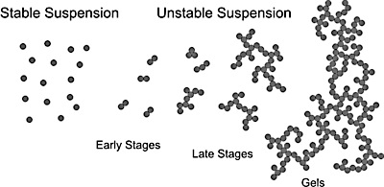
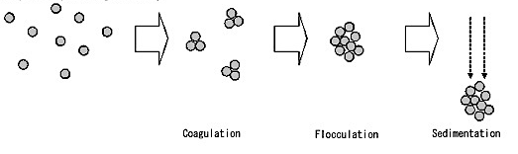
Aggregates: open networks, closed aggregate

Slide 13
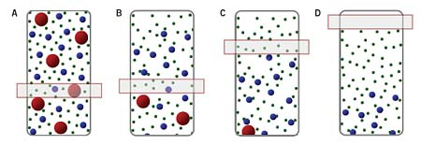
Sedimentation rate
Stock’s law
V=[D²(d₁-d₂)]/18η
V=[2r²(d₁-d₂)]/9η
Factors: decomposition that lead to salting in or out, pH change with change in p. size distribution and temperature (cycle)
Notes:
Deriving forces???

Slide 14
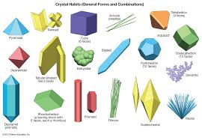
Crystal Habit
It is the appearance of agglomeration of crystals.
It is affect the suspension sedimentation, physical stability, redispersibility, and appearance
It causes a tendency to clumps that have little affinity to disperse and retard the dissolution and bioav.
Factors: decomposition that lead to salting in or out, pH change with change in p. size distribution and temperature (cycle)

Slide 15
Formation
Precipitation methods
1-Organic solvent (ethanol, methanol, propylene glycol, poly ethylene glycol)
2-pH change ( for drugs that solubility depends on pH change) like insulin PZI
ACTH zinc susp. .
3-Double decomposition : simple chemistry like white lotion zinc polysulphide (zinc sulphate and sulphureted potash
Dispersion method
It needs solvent or medium capable to wet of drug solid particles and disperse
May needs surfactant to enhance wetting

Slide 16
Dispersed systems
The particles dispersed with aid of agent lower the interfacial tension
Viscosity enhancing agent (as adjunct )
Barrier forming agent (protective colloids)
Combination is required!!!
Factors contribute in stock’s law
1-ps
2-density
3-viscoity
To effect on density
Sorbitol, glycerin, PVP, Sugar, PEG
Sod.CMC (anionic), MC, HPMC (nonionic), poly acrylic(carbopol for external and gel)
0.5% in inj.
pH6-10

Slide 17
Highly developed thixotropic is desirable
The properly formulated suspension that prevent sedimentation, aggregation, and caking by virtue of high yield viscosity at rest, and at sharp agitation reduces the viscosity to permit pouring and dispense of the product

Slide 18
Preservatives
Colors
Perfumes
Flavors
Color should be in small quantities and compatible
Flavor compatible with vehicle.
Package (usage dependent)

Slide 19
Each suspension is a separate case and absolute general procedure is not possible
Particle size (<5micron) reduction for dispersion method
1- Pulverization by fluidize energy mill
2- Comminution by spray dryer
Particle size (<5micron) reduction for precipitation (controlled crystallization)
The supersaturated solution should be formed and quickly cooled with rapid stirring

Slide 20
Colloidal mill (rotor and stator) to generate shear
Ultrasound shaker for high intensity mixing (not applicable commercially) reduce size specially when used with surfactant.
Excessive shear like high temp. should be avoided- breakdown some polymers

Slide 21
Evaluation of suspension stability
Tests are complex and so far to be staisfactory
Some are drastic and some are empiric
destroy
Not mathematically
H_{u}/H_{o}???
Redispersability

Slide 22
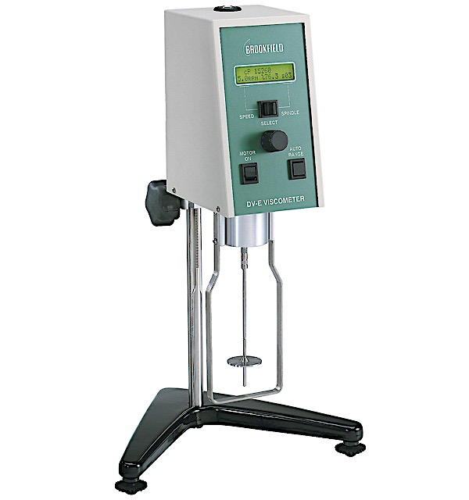
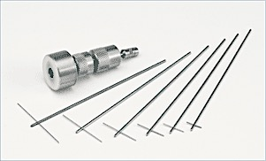
Brookfield viscometer using T-bar
Principle shear rate vs shear stress

Slide 23
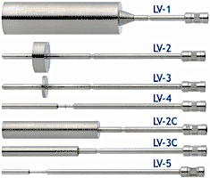
15 to 20,000 cp
200 to 400,000 cp
1000 to 2,000,000 cp

Slide 24
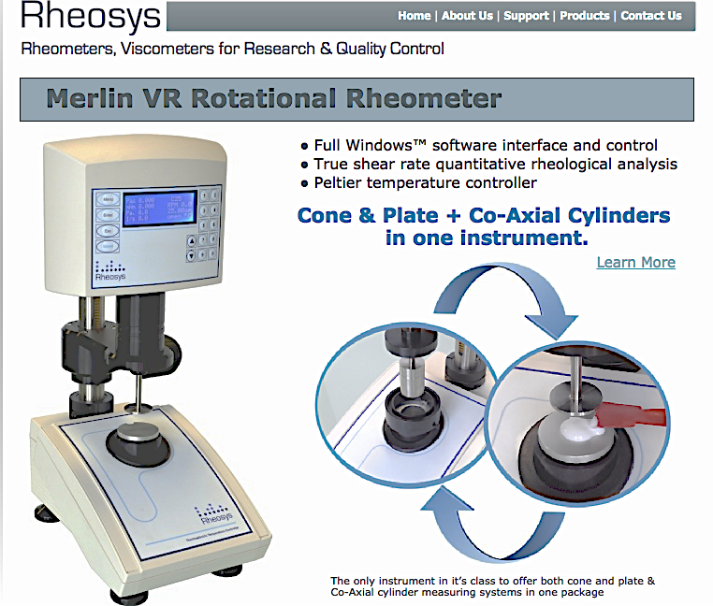
New Rheometers

